Slide 1

Modelling low energy particle tracks in biologically relevant media
Gustavo García^{1, 2}
¹Instituto de Física Fundamental
Consejo Superior de Investigaciones Científicas
(IFF-CSIC), Madrid, Spain
²Centre for Medical Radiation Physics, University of Wollongong, NSW, Australia

Slide 2
Motivation
Most of radiation damage is produced by secondary species (electron induced molecular dissociation, chemical reactions)
Side effects in radiotherapy remain unclear
Increasing number of PET scanning applications (medical diagnostics, hadron therapy dosimetry)
A new dosimetry is required to describe nanoscale radiation interactions (nanodosimetry)

Slide 3
Low energy particle interaction examples
High energy photon radiotherapy
PET scanning for medical diagnostics
Hadrontherapy
Indirect damage by electron transfer from secondary species

Slide 4
Low energy particle interaction examples
High energy photon radiotherapy
PET scanning for medical diagnostics
Hadrontherapy
Indirect damage by electron transfer from secondary species

Slide 5
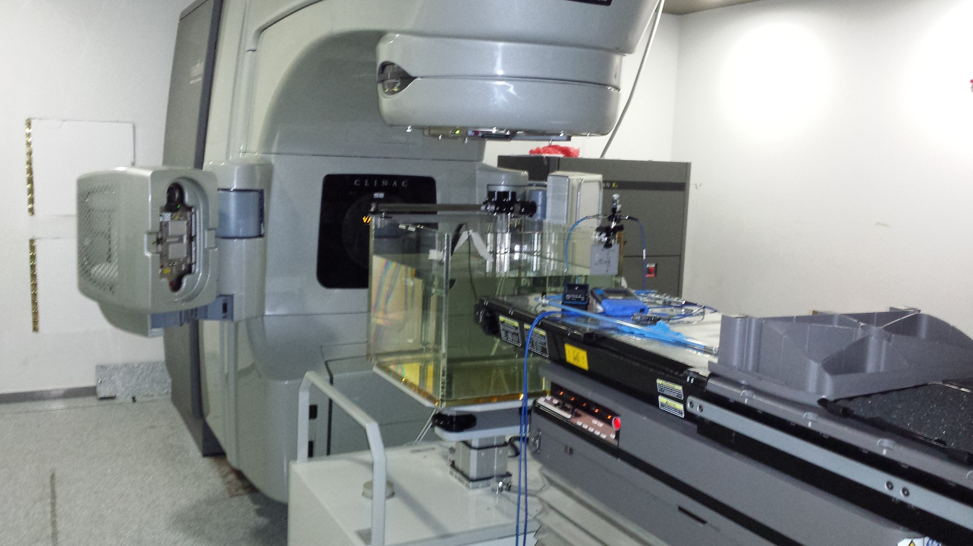
LINAC accelerator for radiotherapy

Slide 6
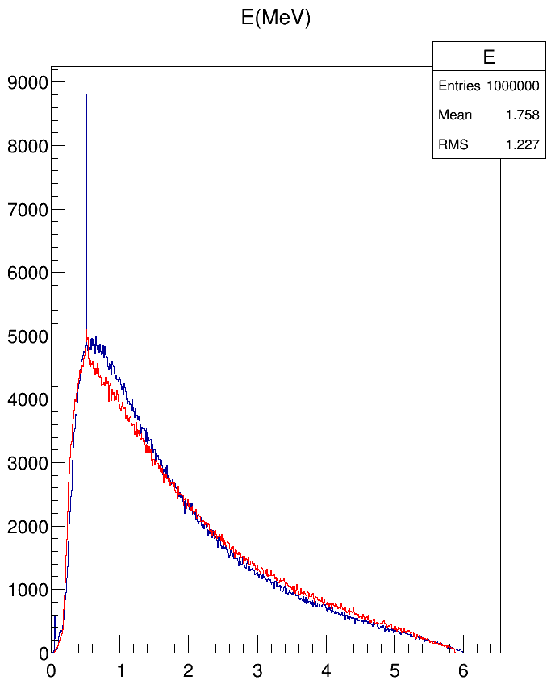
Photon emission spectra (6 MV)
I (a.u.)
Average energy:
1.082 MeV
Present simulated space-phase
Manufacturer’s
simulated
spectrum
MeV

Slide 7
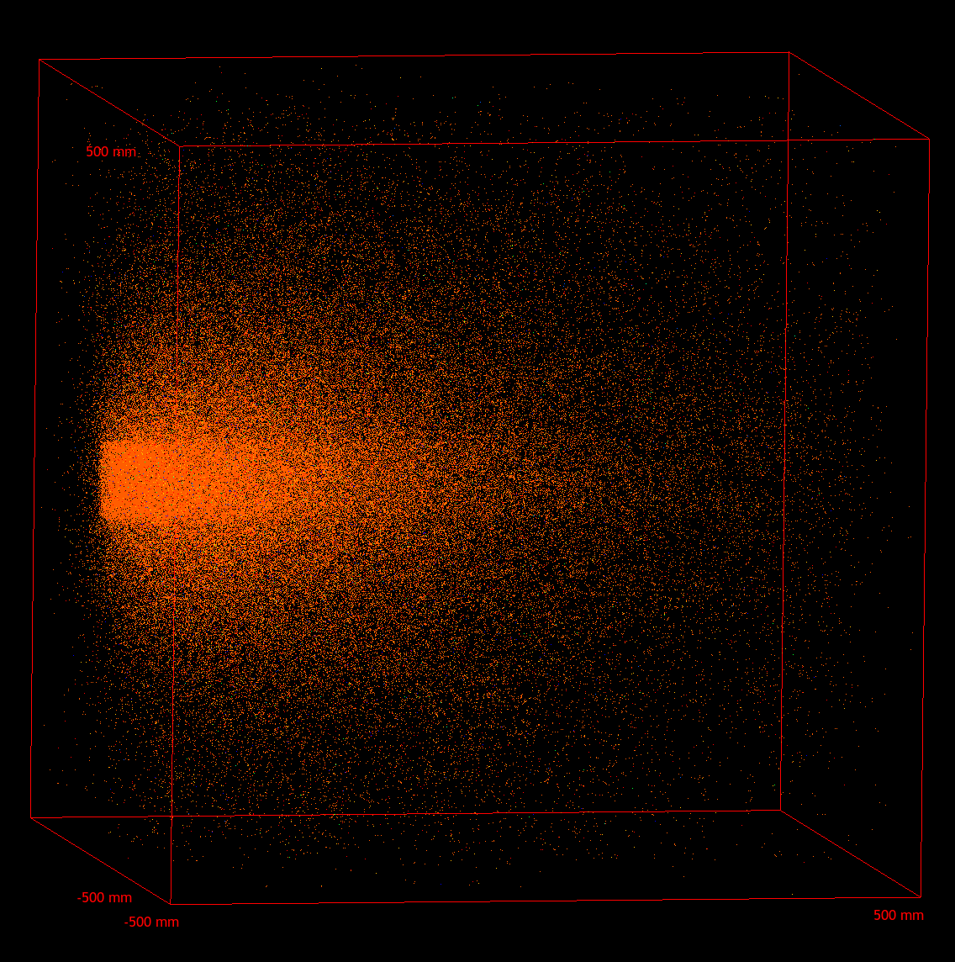
6MV photon beam interactions in a 1 m³ liquid water phantom

Slide 8
Low energy particle interaction examples
High energy photon radiotherapy
PET scanning for medical diagnostics
Hadrontherapy
Indirect damage by electron transfer from secondary species

Slide 9
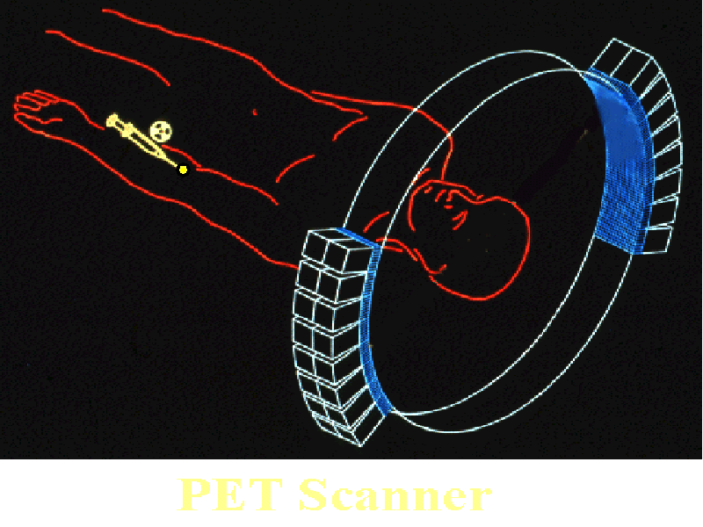
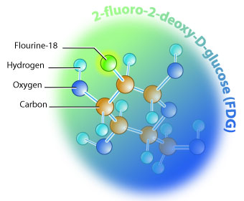
PET imaging in nuclear medicine
Positron emitters:
Neutron defficient beta emitters: Na-22, F-18
FDG samples (fluoro-deoxy-glucose)
Imaging:
2γ annihilation
Coincident detection
PET Scanner

Slide 10
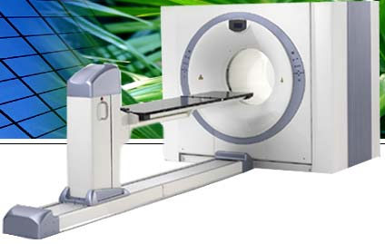
Positron Emission Tomography - Computed Tomography (PET/CT)

Slide 11
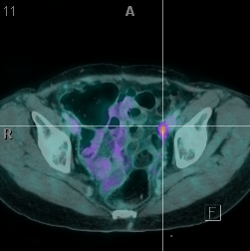
PET/TC with FDG-F18

Slide 12
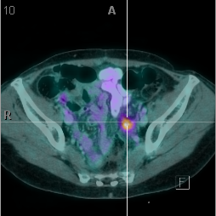
PET/TC with FDG-F18

Slide 13
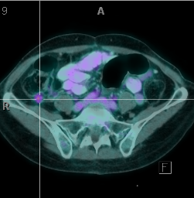
PET/TC with FDG-F18

Slide 14
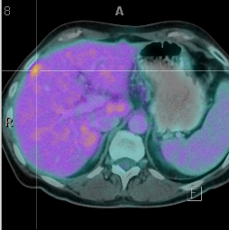
PET/TC with FDG-F18

Slide 15
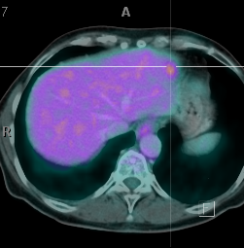
PET/TC with FDG-F18

Slide 16
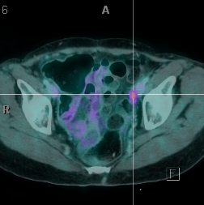
PET/TC with FDG-F18

Slide 17
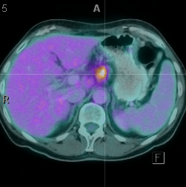
PET/TC with FDG-F18

Slide 18
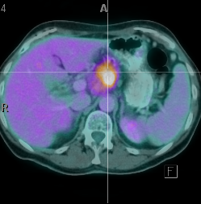
PET/TC with FDG-F18

Slide 19
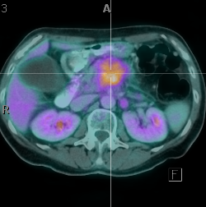
PET/TC with FDG-F18

Slide 20
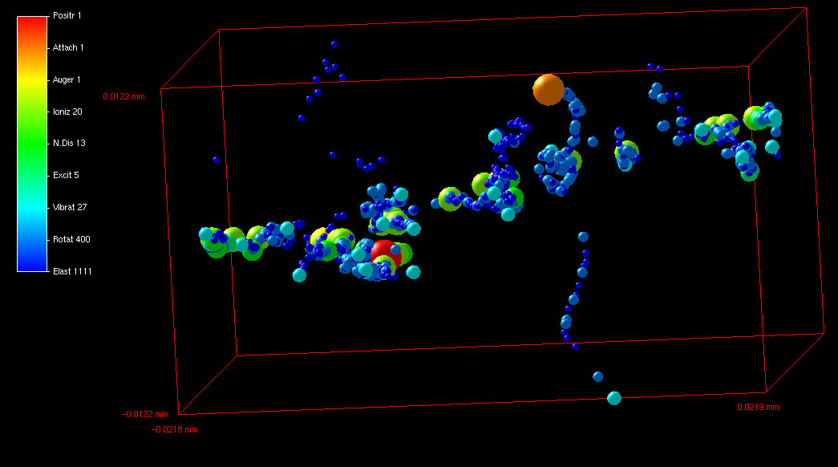
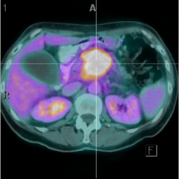
PET/TC with FDG-F18

Slide 21
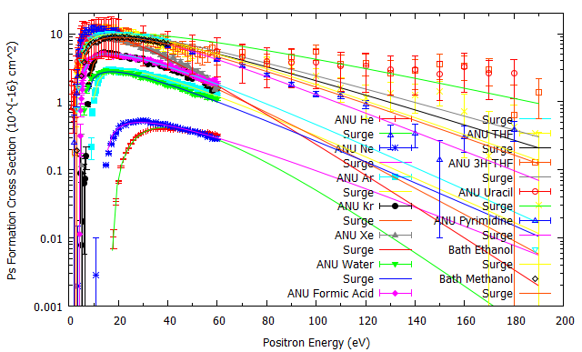
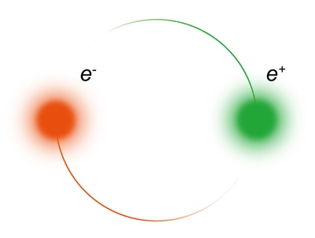
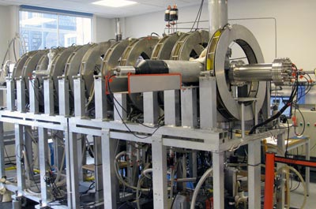
Positronium formation
ANU
Two particle system but three body problem
Positronium scattering
Neutral positronium scatters like
a charged particle (e⁻)
Can attach molecules?
Need Theory
UCL

Slide 22
Low energy particle interaction examples
High energy photon radiotherapy
PET scanning for medical diagnostics
Hadrontherapy
Indirect damage by electron transfer from secondary species

Slide 23
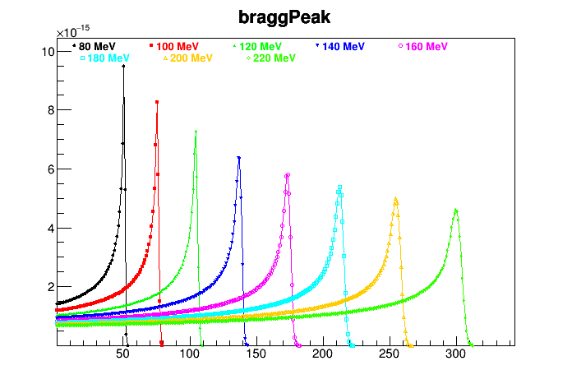

Hadrontherapy: H, He, C, O ion beams
Proton Bragg peak in water
$${}_{8}^{15}{\text{O}}→{}_{7}^{15}{\text{N}}+{\text{e}}^{\text{+}}$$
Energy deposition (a. u.)
e⁻
Radicals: H, OH
e⁺
80 keV
¹⁵O
0
Penetration (mm)

Slide 24
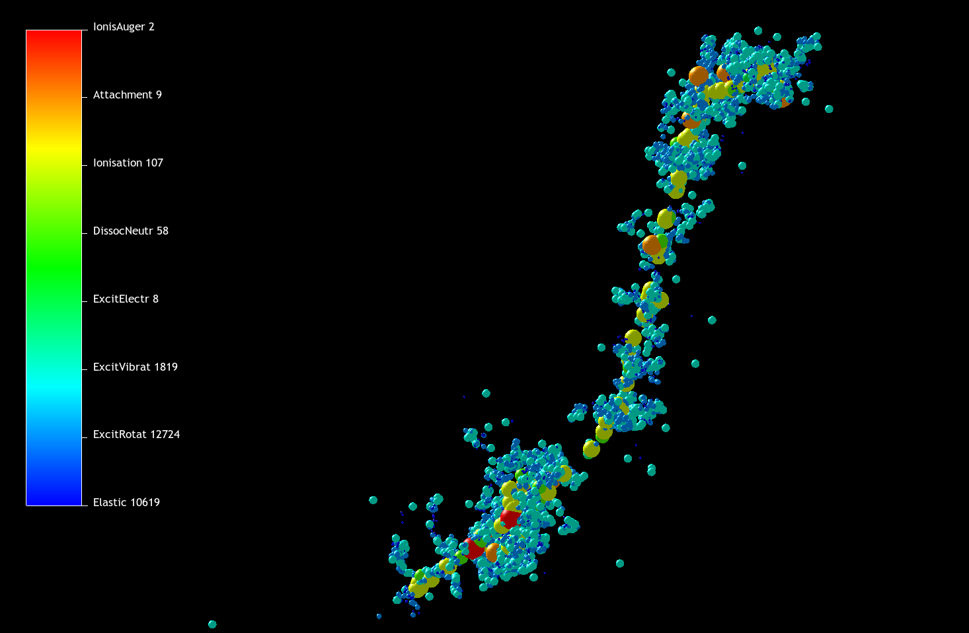
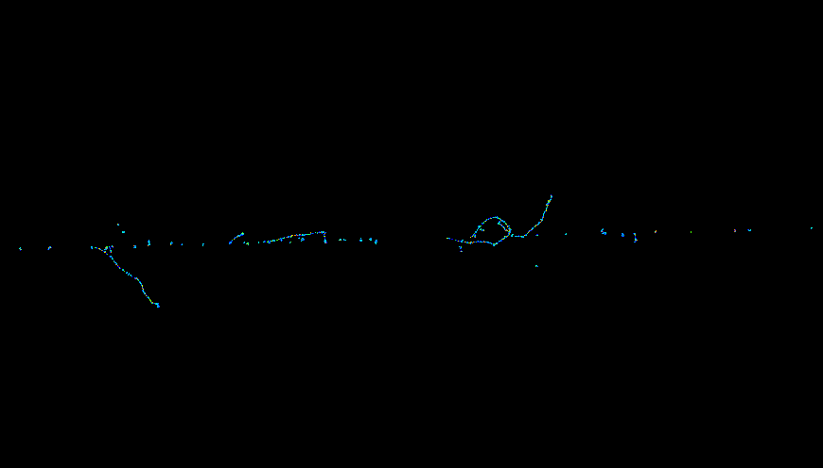
1MeV proton in liquid water
Auger electron 2
Electron attachment 9
Ionisation 107
Neutral dissociation 58
Electronic excitation 8
Vibrational excitation 1819
Rotations 12724
Elastic 10619
3 μm
15 μm

Slide 25
Low energy particle interaction examples
High energy photon radiotherapy
PET scanning for medical diagnostics
Hadrontherapy
Indirect damage by electron transfer from secondary species

Slide 26
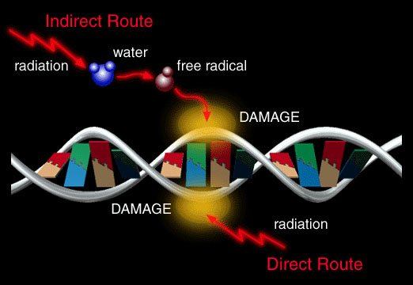
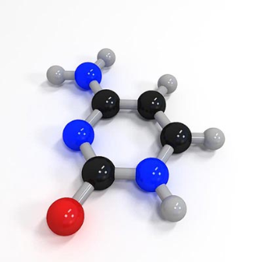

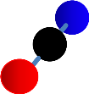
Indirect damage by electron transfer
OH⁻
Thymine
CNO⁻
e⁻

Slide 27
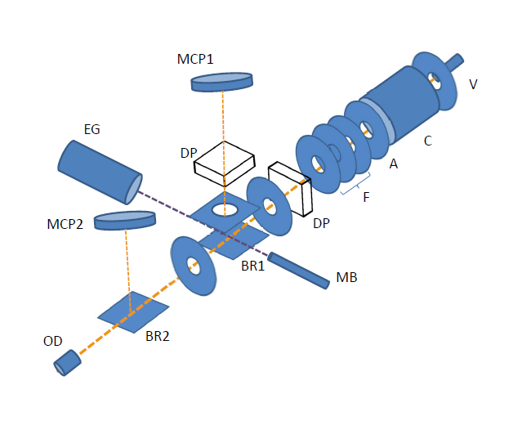
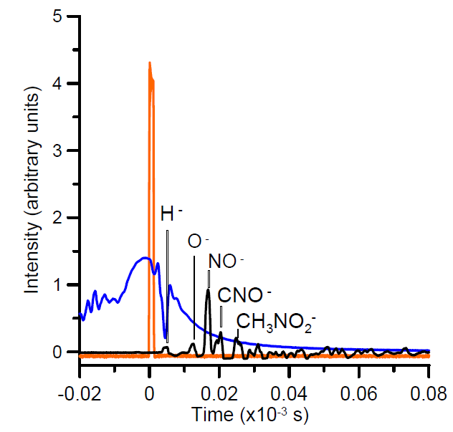
Dissociation induced by electron transfer from negative radicals (O⁻)
Magnetic
field
Nitromethane fragments
O⁻ incident beam

Slide 28
Modelling procedure
Available data libraries (Livermore , NIST)
Photons (all energies)
Protons (> 1 MeV)
Positrons (> 10 keV)
Electrons (>10 keV)
General MC Programme GEANT4
+ GAMOS Architecture
Source geometry and emission spectra
LEPTS Code
Protons (< 1 MeV)
Positrons (< 10 keV)
Electrons (<10 keV)
Radicals (implementing)
Interaction cross section data
Energy loss distribution functions
Angular distribution functions
Laboratory (preclinical) verification

Slide 29
Input data
High energy photons: (Literature: Evaluated Data Bases→GEANT4)
High energy (>10keV) electrons/positrons : (First Born approximation- Bethe surfaces→GEANT4)
Low energy electrons , positrons and radicals: Experimental and theoretical data:
Interaction cross section LEPTS
Energy and angular distribution functions

Slide 30
Low energy electron interaction data
Experimental data sources:
Electron and positron scattering cross sections with molecules: CSIC, Flinders University (FU), Université de Liège (UL), Sophia University (SU), Australian National University (ANU)
Electron transfer to molecules: CSIC, New University of Lisbon (UNL)
Thoretical methods:
Electron and positron scattering with molecules: CSIC (IAM-SCAR), Open University (R-matrix)

Slide 31
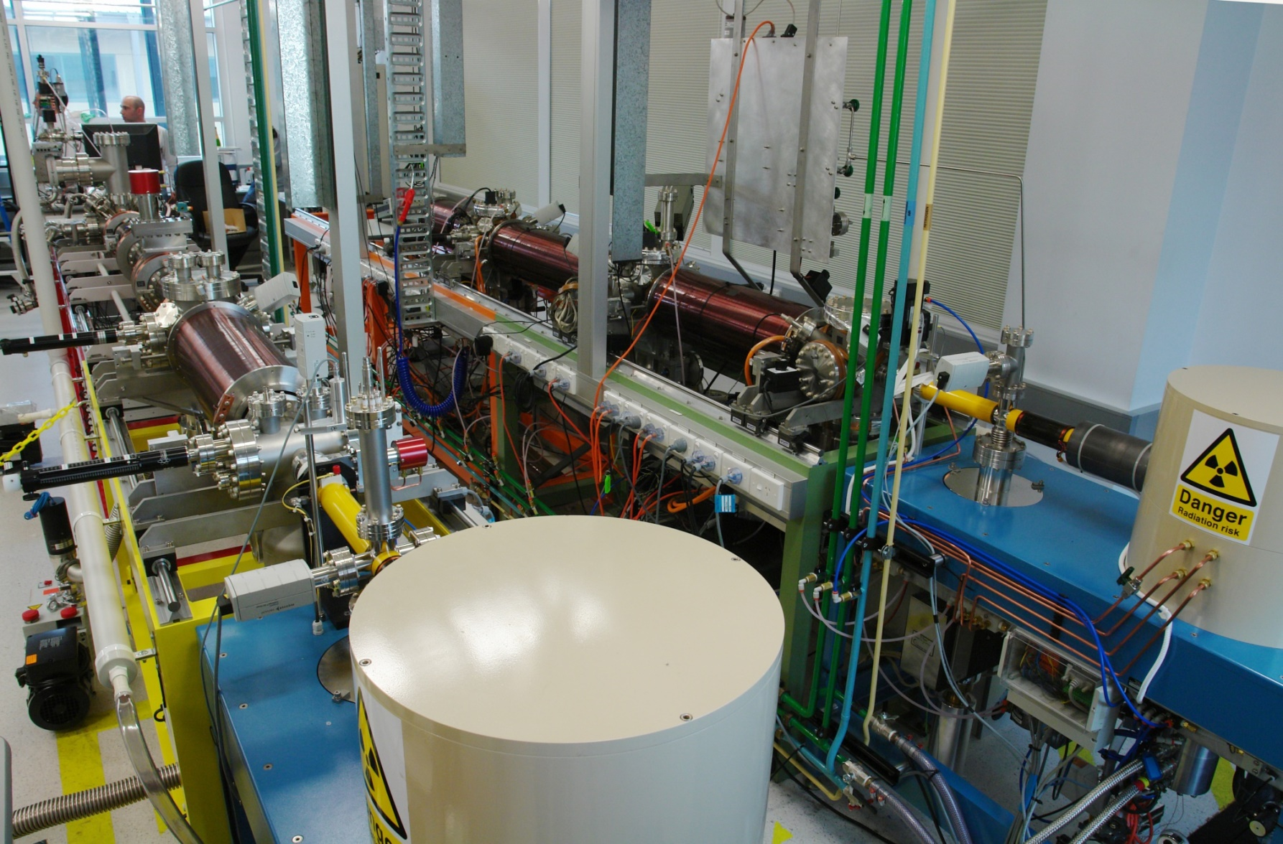
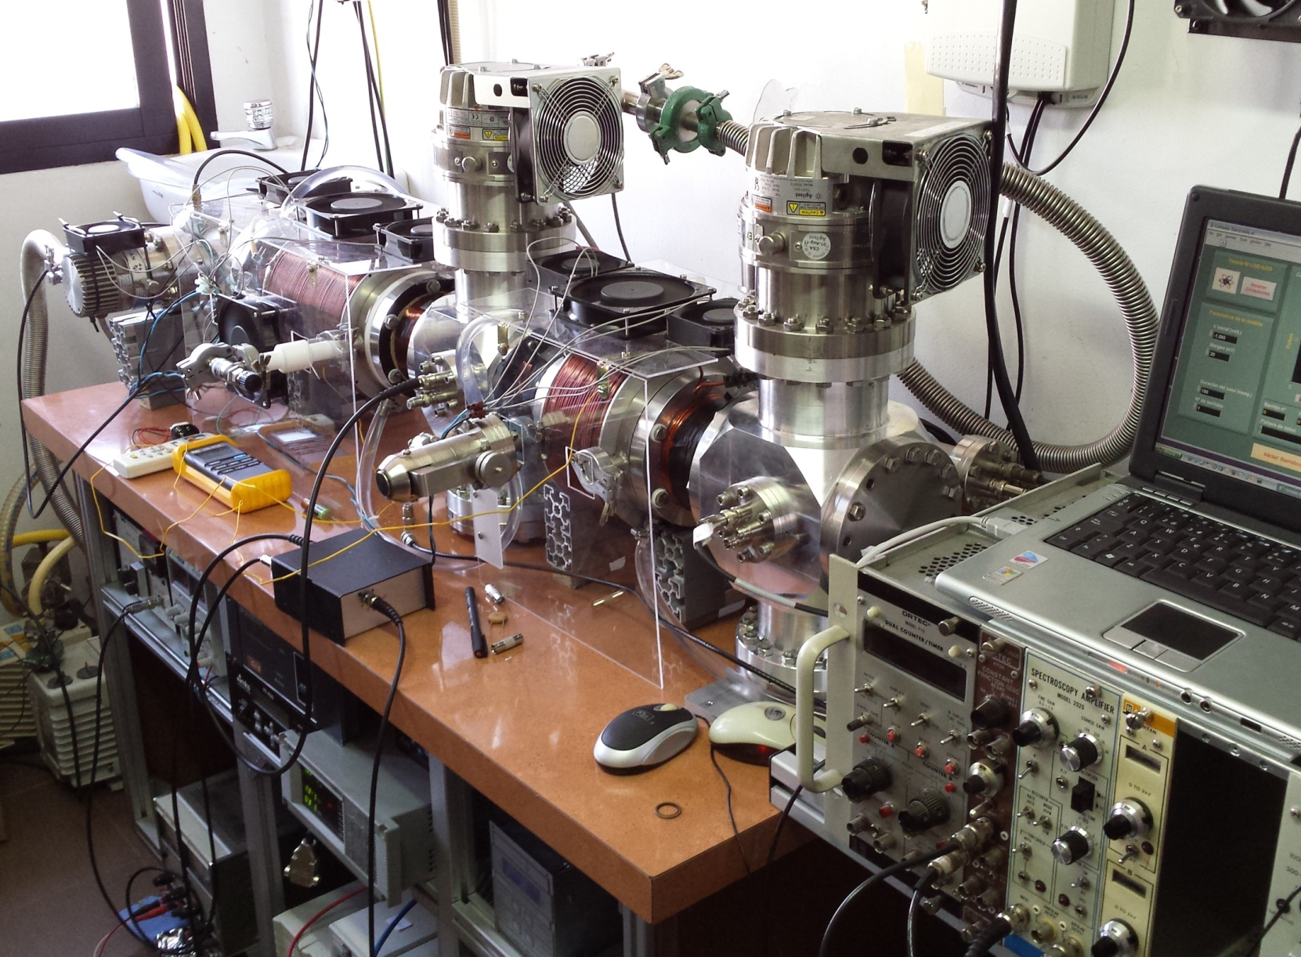
Experimental systems

Slide 32
Calculations Electron and positron scattering in molecular and condensed media
Atoms: Model potential representation,
Molecules:
Independent atom model (IAM), Aditivity rule (AR) with screening corrections (SCAR) and interference terms
Additional dipole rotational excitations (FBA)
Condensation effects: Atomic and molecular clusters, liquids, solids (IAM-SCAR)
Low energy (< 20 eV) extension : R-Matrix procedure (Open University-UK)

Slide 33
Atoms
e⁻
+
−
p⁺
Electrons: V(r)= V_{st}(r)+V_{ex}(r)+V_{pol}(r)+i[V_{abs}(r)]
Positrons: V(r)= V_{st}(r)+V_{pol}(r)+i[V_{abs}(r)+ V_{ps}(r)]

Slide 34
Calculations Electron and positron scattering in molecular and condensed media
Atoms: Model potential representation,
Molecules:
Independent atom model (IAM), Aditivity rule (AR) with screening corrections (SCAR) and interference terms
Additional dipole rotational excitations (FBA)
Condensation effects: Atomic and molecular clusters, liquids, solids (IAM-SCAR)
Low energy (< 20 eV) extension : Single-Centre Expansion and R-Matrix procedures
CSIC-Madrid, University of Rome, Open University-UK

Slide 35
Molecules
Differential cross sections
Integral cross sections

Slide 36
Calculations Electron and positron scattering in molecular and condensed media
Atoms: Model potential representation,
Molecules:
Independent atom model (IAM), Aditivity rule (AR) with screening corrections (SCAR) and interference terms
Additional dipole rotational excitations (FBA)
Condensation effects: Atomic and molecular clusters, liquids, solids (IAM-SCAR)
Low energy (< 20 eV) extension : R-Matrix procedure (Open University-UK)

Slide 37
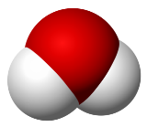





Condensed matter
σ→σ^{eff}
σ_{i}^{eff}
σ_{ij}
σ_{i}
σ ^{c}
High → Intermediate → Low Energy
Corrective factor: s=σ^{eff}/σ=[1+(σ ^{c}/σ)^{p}]^{1/p}
P=-21→0,5% convergence

Slide 38
Calculations Electron and positron scattering in molecular and condensed media
Atoms: Model potential representation,
Molecules:
Independent atom model (IAM), Aditivity rule (AR) with screening corrections (SCAR) and interference terms
Additional dipole rotational excitations (FBA)
Condensation effects: Atomic and molecular clusters, liquids, solids (IAM-SCAR)
Low energy (< 20 eV) extension : R-Matrix procedure (Open University-UK)

Slide 39
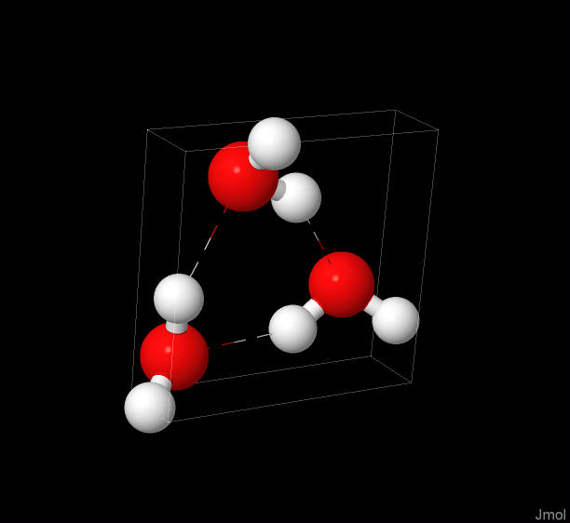
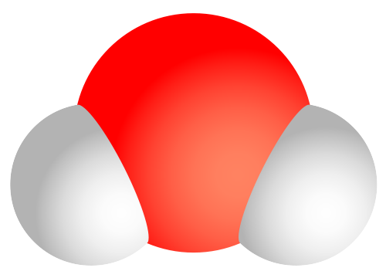
IAM-SCAR
water
(H₂O)₃ cluster
Liquid water
H₂O molecule
e⁻ , e⁺ -track

Slide 40
EXAMPLE:
Low Energy Particle Track Simulation (LEPTS)
10 keV positrons in liquid water
Primary particle cross section data: Calculations (IAM-SCAR), measurements (ANU) and literature
Secondary electron scattering cross sections: Calculations, measurements (CSIC, ANU, FU)
Condensation effects: from the gas to the liquid phase (SCAR, JCU)
Energy loss distribution functions (CSIC, FU)

Slide 41
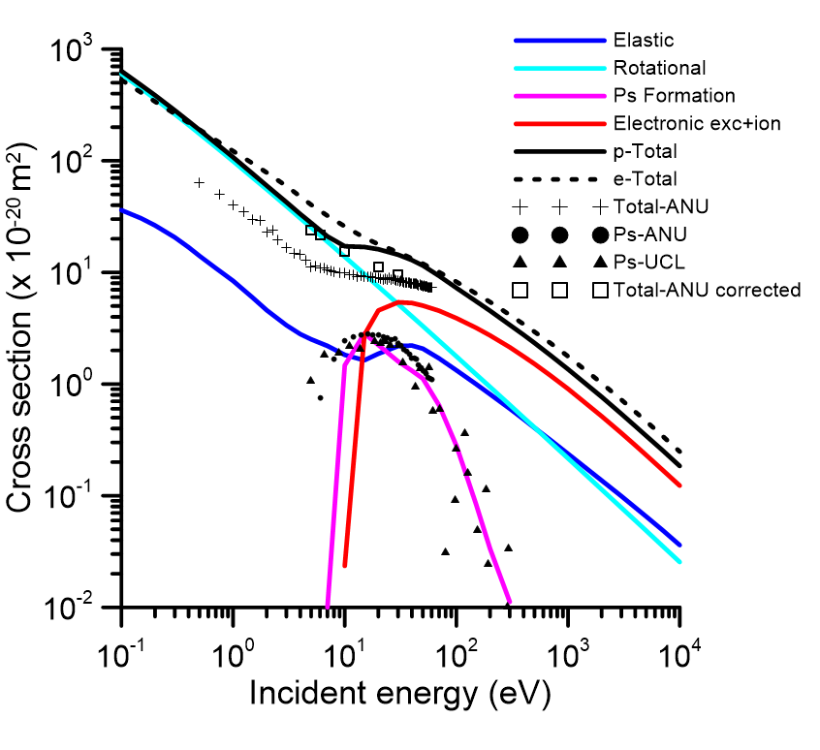
Cross sections for positrons and electrons in water
Electrons
Positrons

Slide 42
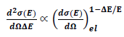
p-water: angular distribution functions
Elastic
Inelastic

Slide 43
Water: Energy loss distribution functions

Slide 44
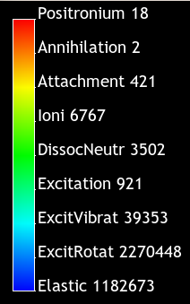
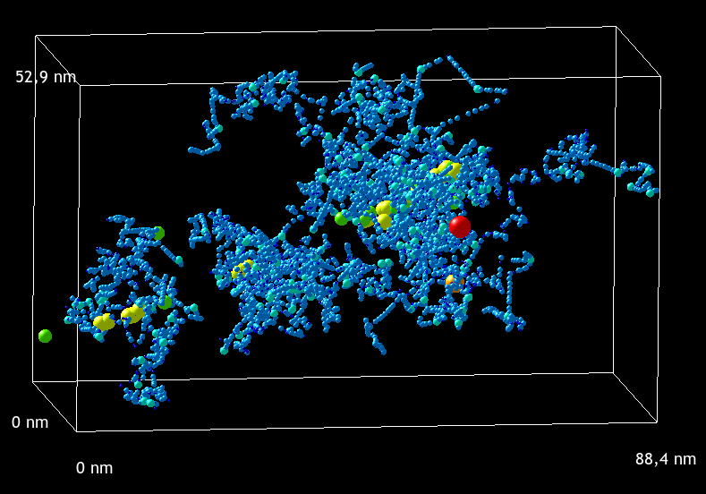
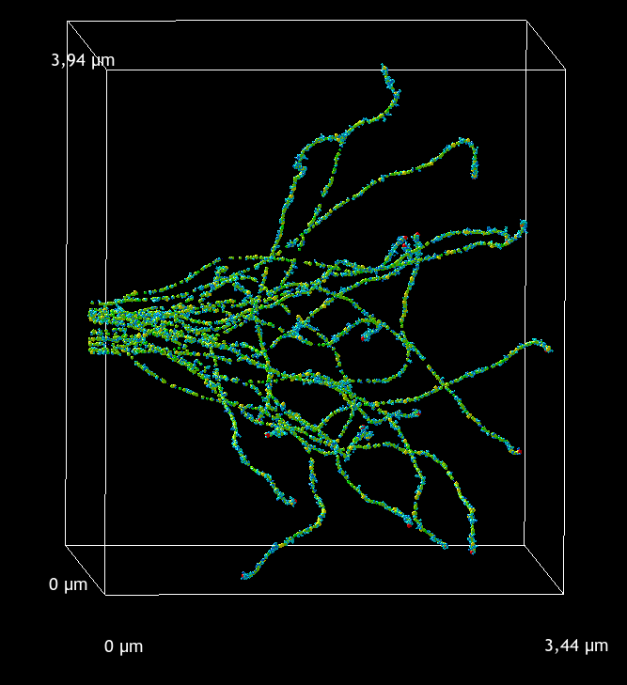
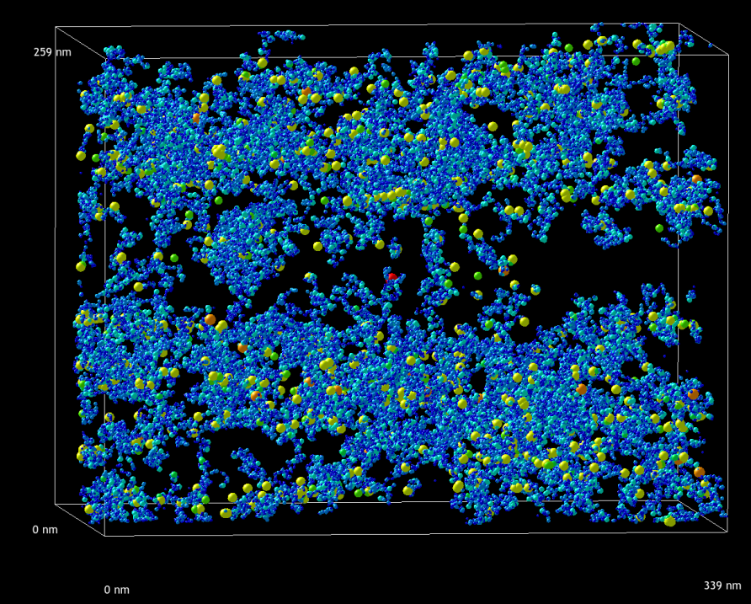
10 keV positron tracks in liquid water

Slide 45
Energy deposition of 10 keV positrons in liquid water

Slide 46
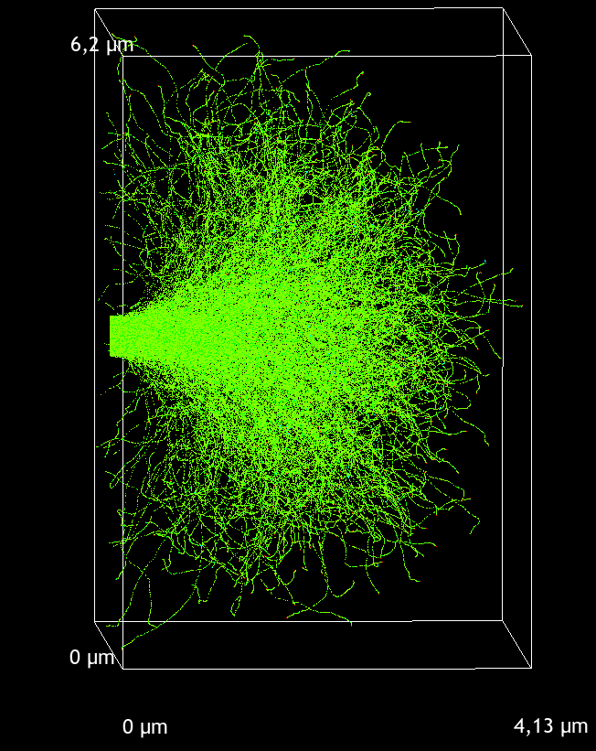
Low dose region

Slide 47
Conclusions
Integrating GEANT4 (high energy)+GAMOS (geometry)+LEPTS (low energy) to get a suitable tool to simulate single particle tracks over a wide energy range.
The Low Energy Particle Track Simulation procedure provides information about induced molecular dissociations in nanovolumes (nanodosimetry)
To incorporate radical interactions with biological molecules new collisional data is needed (some experiments are currently running in Madrid and Lisbon)
Validation experiments in preclinical situations are also in progress (Hospital Universitario Puerta de Hierro, University of Sherbrooke, CSIC-Madrid)

Slide 48
Acknowledgements
Madrid Group: F. Blanco, A. Muñoz, M. Fuss, L. Ellis-Gibbings, A. Traore, K. Krupa
Lisbon (UNL): P. Limão-Vieira, F. Ferreira, D. Almeida
Flinders University (Adelaide): M. Brunger
ANU (Canberra): S. Buckman, J. Sullivan, R. McEachran
J. Cook University (Townsville): R. White
IOP (Belgrade): Z. Petrovic
Open University (UK): J. Gorfinkiel
University of Innsbruck: F. Gianturco
Sherbrooke University: L. Sanche

Slide 49



Acknowledgements
Madrid Group: F. Blanco, A. Muñoz, M. Fuss, L. Ellis-Gibbings, A. Traore, K. Krupa
Lisbon (UNL): P. Limão-Vieira, F. Ferreira, D. Almeida
Flinders University (Adelaide): M. Brunger
ANU (Canberra): S. Buckman, J. Sullivan, R. McEachran
J. Cook University (Townsville): R. White
IOP (Belgrade): Z. Petrovic
Open University (UK): J. Gorfinkiel
Sherbrooke University: L. Sanche

